Slide 1
01
Long-context in-context compression
Tl;dr Effective algorithm for long-context compression using dedicated compression tokens.
mh/307406

Slide 2


In-Context Compression: Two Key Use Cases
Long-Context Summarization (Memory):
Challenge: Extract key information from very long contexts (e.g., video streams, large documents).
Solution: Compress the context into fewer tokens for efficient Q&A.
Example: Summarize a 24-hour video stream from Astra to answer user queries.
A very long document / personal memory / video
Compressed context
Question
Answer
The prince found the dragon nestled in a sun-dappled meadow, surrounded by wildflowers. It was enormous,..
[Latent context summary]
Who found the dragon?
The prince
Task-Based Prompt Compression:
Challenge: Improve model performance on a task using a few examples.
Solution: Compress a set of example prompts to maximize performance on new instances.
Benefit: Can be an in-context alternative to fine-tuning methods like LoRA.
Compressed task representation
A new sample from task
Answer
Multiple examples for a given task
en: apple
sp: manzana
en: pear
sp: pera
en : grape
sp: uva
en: peach
sp: durazno
[Latent task summary]
en: banana
sp: banano

Slide 3
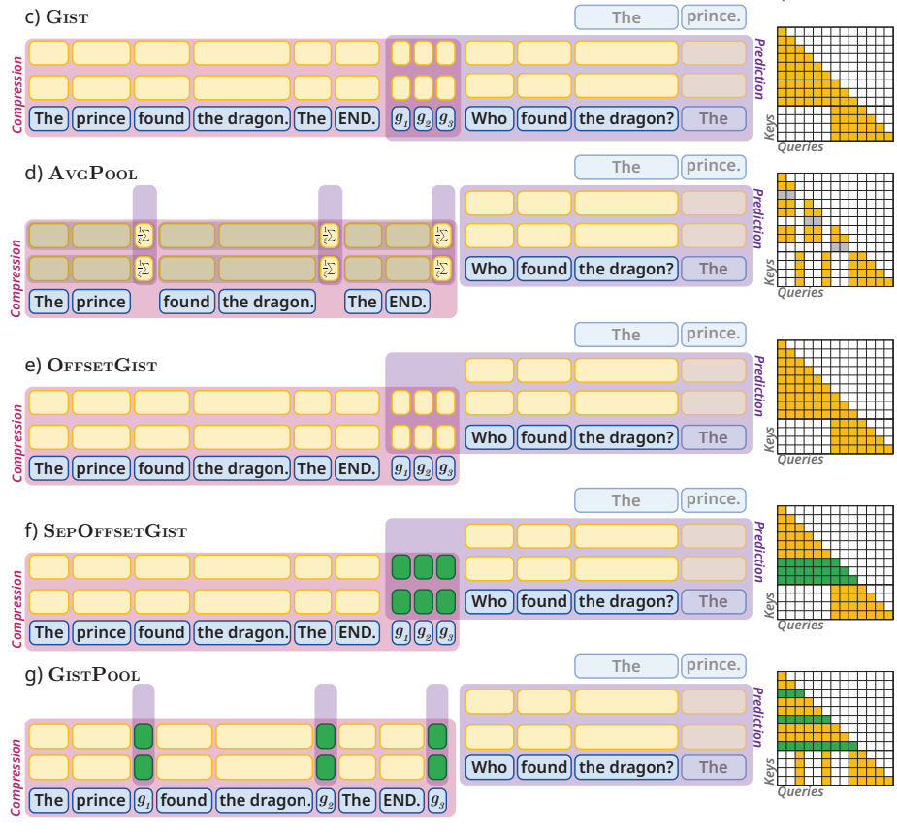
Our Approach
Bottleneck Compression Tokens:
Question accesses context only via compression tokens g.
Context discarded after KV-cache of the compression tokes is computed.
Shift Question Activations Up:
This helps align the information flow from the context to the question.
Dedicated Parameters for Compression Tokens:
Full SFT or LoRA on base model.
Disperse Compression Tokens Across Context.

Slide 4
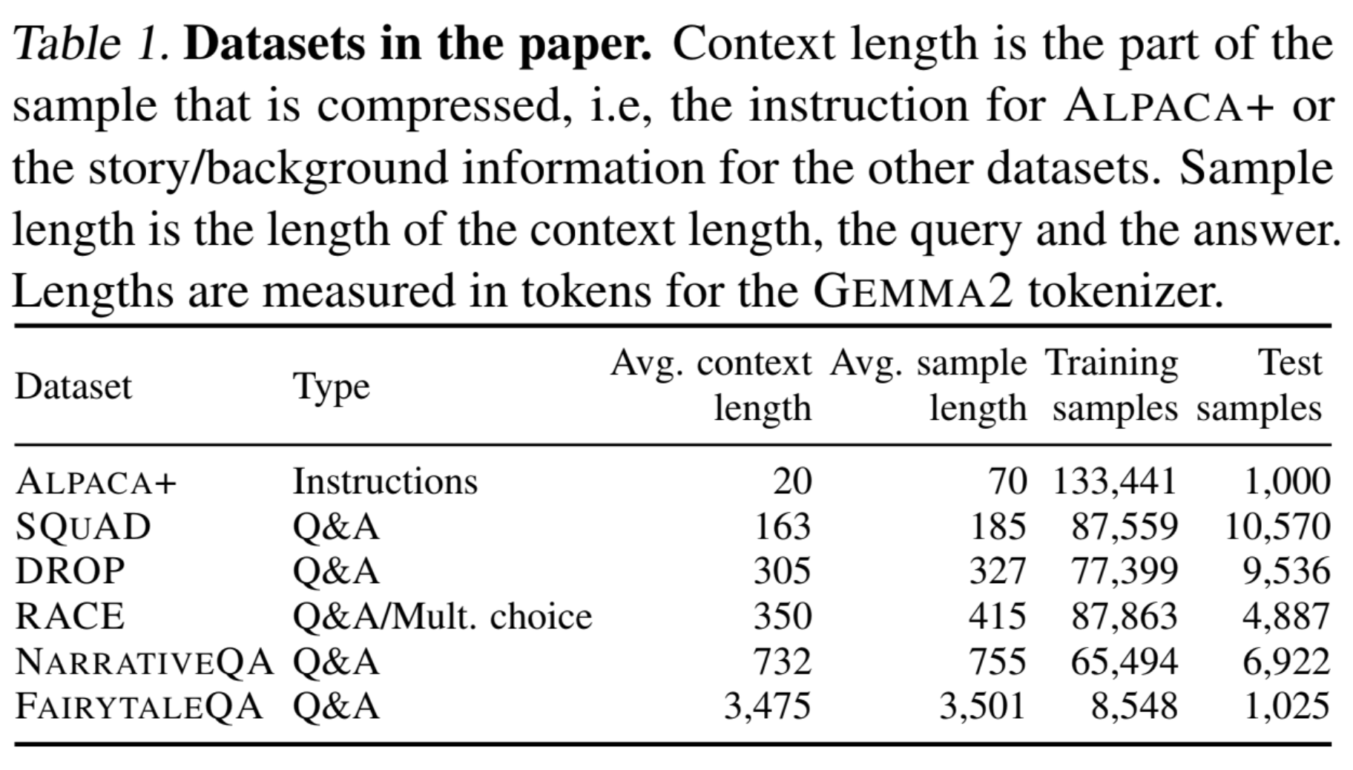
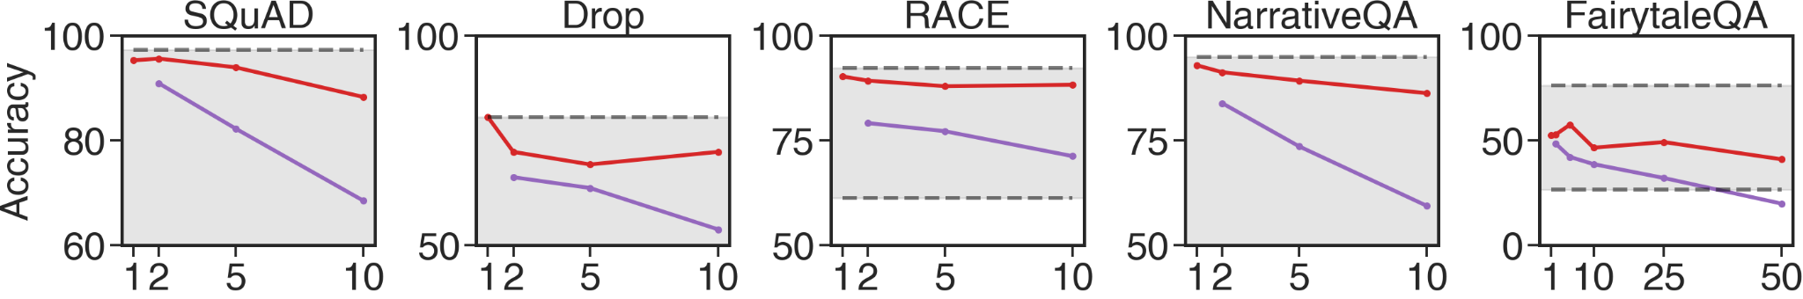


Results
We consider QA-datasets with varying context length and corpora.
Fine-tuned compression on Gemma 2-2B achieves better results than direct compression using much larger Gemini 2.0.
Compression rate
Directly querying Gemini 2.0 for compression.
Our method fine-tuned on Gemma 2-2B.
Performance bounds (lower: drop context entirely, upper: no compression)

Slide 5
Future Work
Developing a dataset-agnostic compression algorithm that generalizes effectively across diverse datasets.
Fine-tuning only the compressor component, while keeping the predictor model as original pre-trained.
Implement "compress-as-you-go" functionality to handle extremely long contexts. This avoids processing the entire KV cache at once.
Explore in-context distillation where a separate compressor model provides task-level "wisdom" summaries to a smaller, efficient predictor model.
Please see more results in a dedicated slide deck go/gistpool-slides, our paper go/gistpool or mh/307406.

Slide 6
In-context Long Context Compression
Paper: go/gistpool
These slides: go/gistpool-slides
mh/307406
Aleks Petrov, Mark Sandler, Andrey Zhmoginov, Nolan Miller, Max Vladymyrov

Slide 7
Prompt compression: motivation
We're moving towards agents that remember you — your data and interaction history.
Maintaining lifelong, in-context interactions across sessions becomes a bottleneck.
Especially challenging with audio and video inputs due to large context size.
LoRA is the current approach, but…
Can’t be easily applied to summarization tasks.
Can’t scale to millions of users.
Requires retraining when the base AI model is updated underneath (User Count x Model Updates = Scalability Challenge).
In-context learning:
Works better and more flexible than LoRA.
We can’t put everything in the context.
Solution: In-context compression!

Slide 8
In-Context Compression: Two Key Use Cases
Long-Context Summarization (Memory):
Challenge: Extract key information from very long contexts (e.g., video streams, large documents).
Solution: Compress the context into fewer tokens for efficient Q&A.
Example: Summarize a 24-hour video stream to answer user queries.
A very long document / personal memory / video
Compressed context
Question
Answer
The prince found the dragon nestled in a sun-dappled meadow, surrounded by wildflowers. It was enormous,..
[Latent context summary]
Who found the dragon?
The prince
Task-Based Prompt Compression:
Challenge: Improve model performance on a task using a few examples.
Solution: Compress a set of example prompts to maximize performance on new instances.
Benefit: Can be an in-context alternative to fine-tuning methods like LoRA.
Compressed task representation
A new sample from task
Answer
Multiple examples for a given task
en: apple
sp: manzana
en: pear
sp: pera
en : grape
sp: uva
en: peach
sp: durazno
[Latent task summary]
en: banana
sp: banano

Slide 9
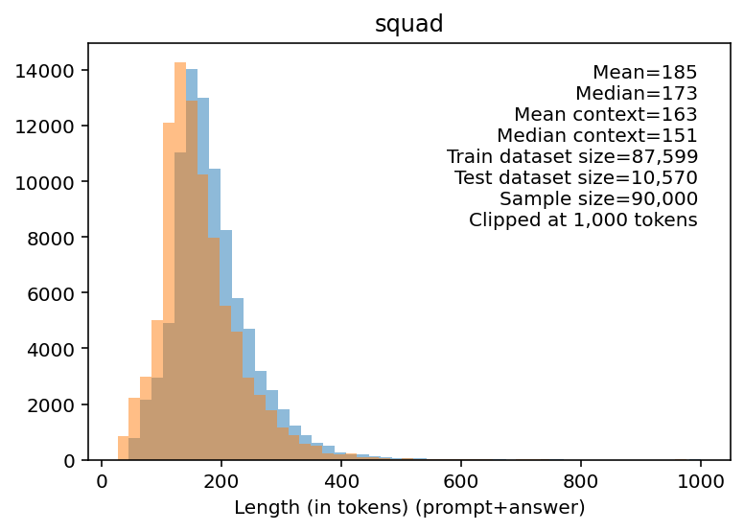
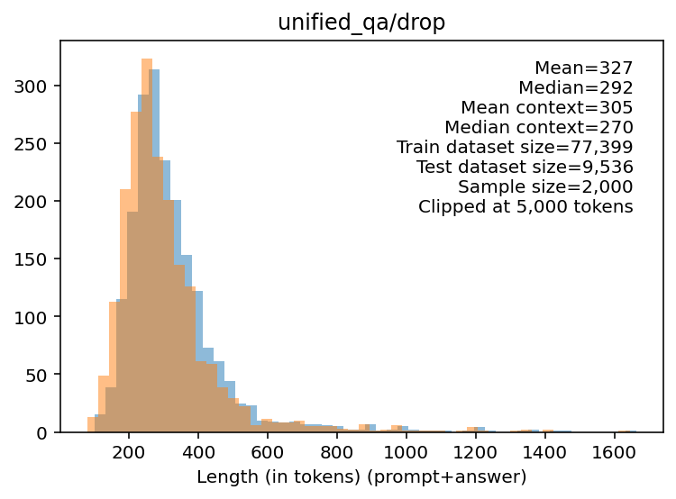
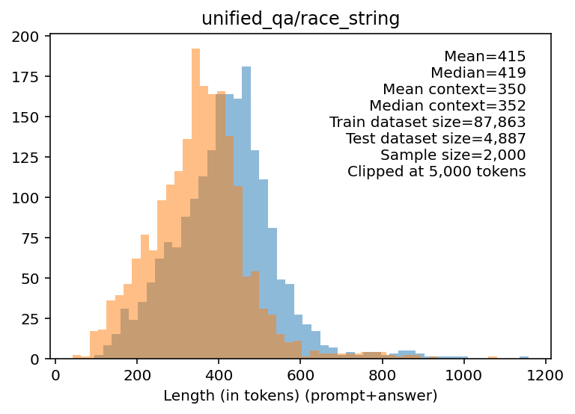
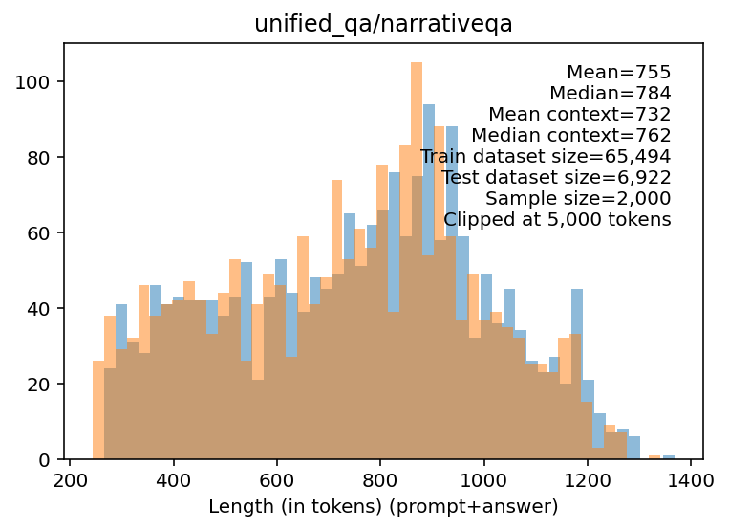
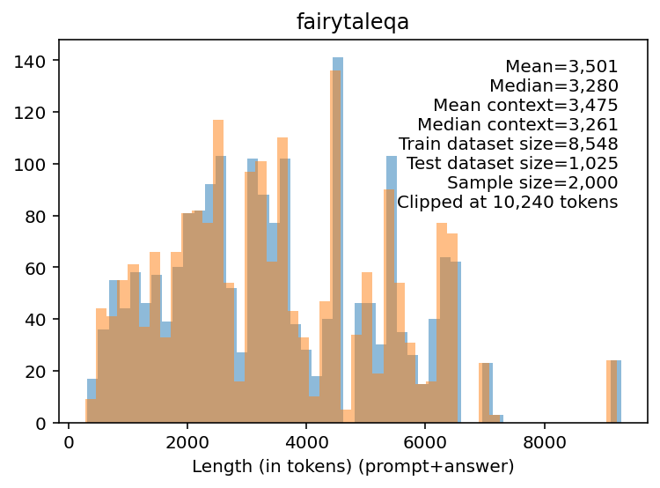
Setup
Model: Gemma 2 2B.
Training: Supervised full fine-tune.
Datasets: We consider QA-datasets with varying context length and the source corpora used for training.

Slide 10
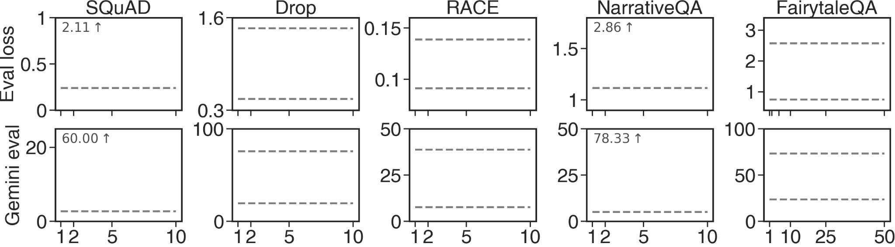
Compression evaluation
Autoregressive loss. (Lower is better)
Gemini 2.0 judging correctness of the full answer.
(Lower is better)
Compression rate

Slide 11
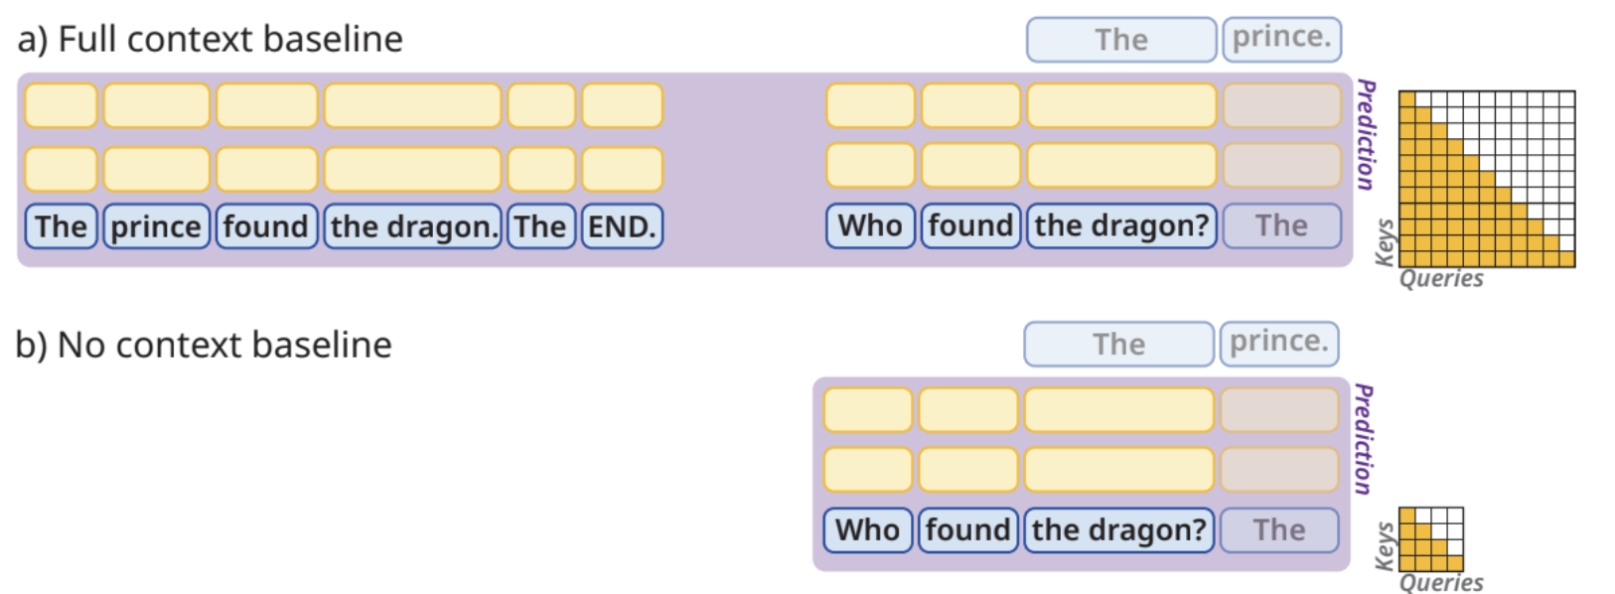
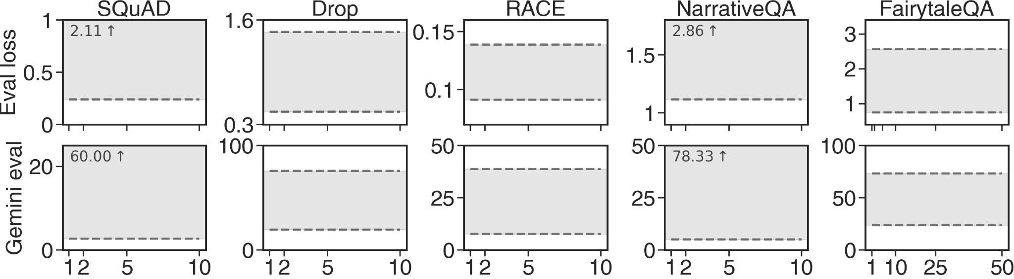
Compression evaluation
No context baseline: SFT with no access to the context.
Full context baseline: SFT with full access to the context.
Compression rate

Slide 12

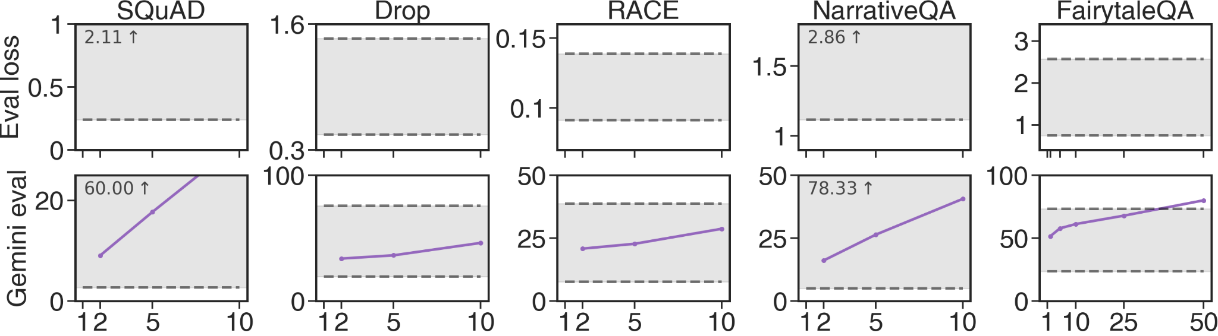
Compression evaluation
Ask Gemini 2.0 to compress the input to a given compression rate.
Compression rate

Slide 13

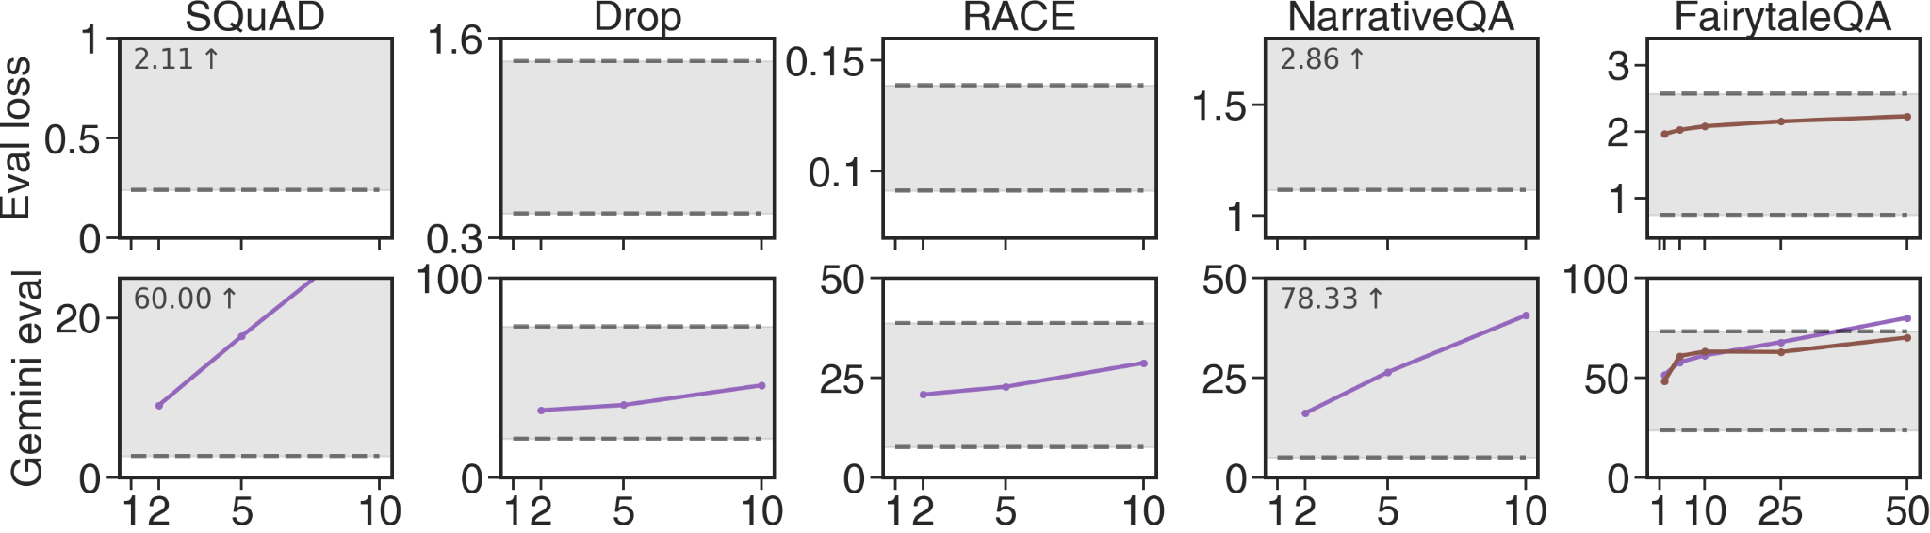
Compression evaluation
Fine-tune Gemma 2 2b on compressed Gemini.
Compression rate

Slide 14
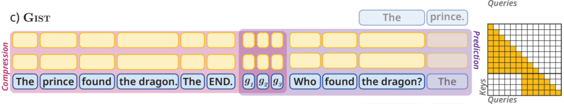

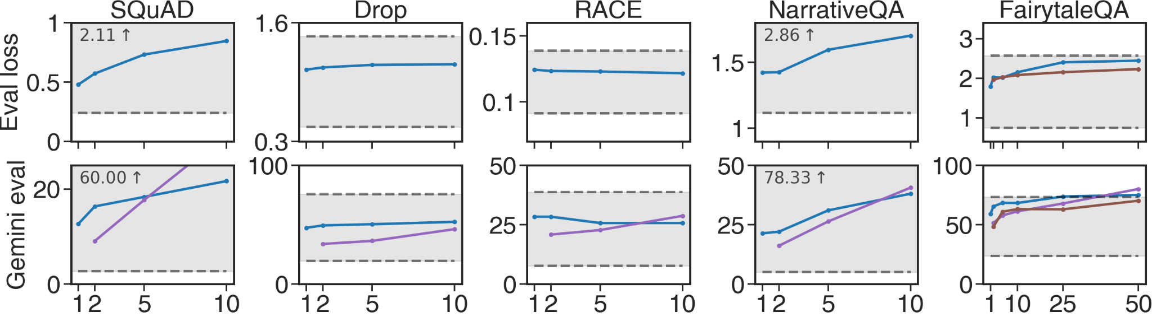
Compression evaluation
Compression rate

Slide 15
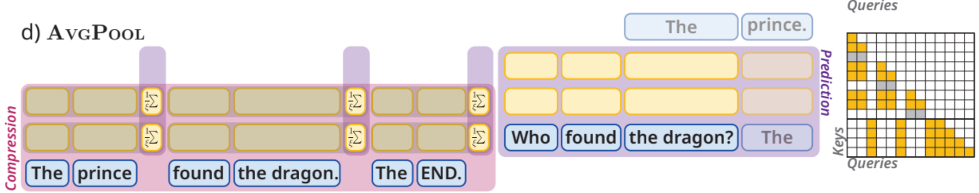

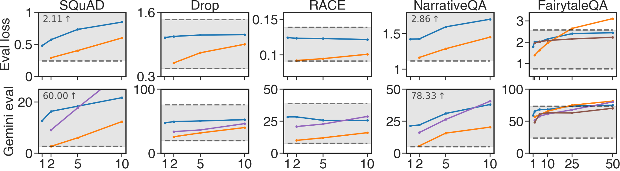
Compression evaluation
Compression rate

Slide 16
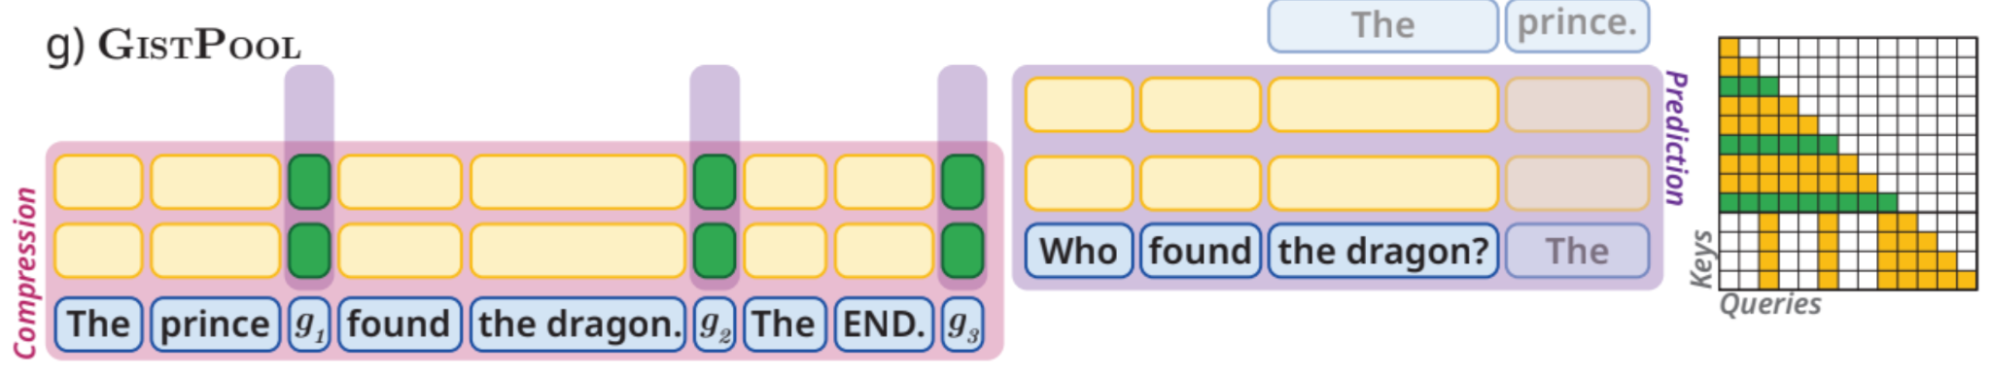

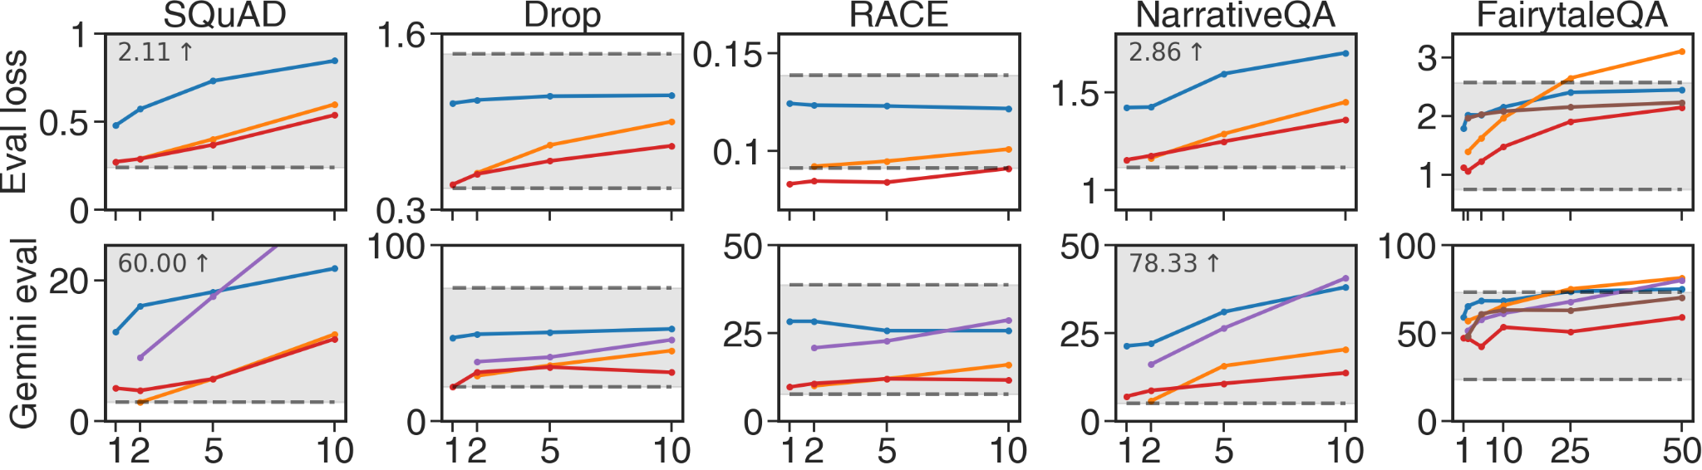
Compression evaluation
Compression rate

Slide 17
GistPool
GistPool = Gist + three improvements:
Activation Offsetting
Dedicated Summarization Parameters
Distributed Gist Tokens

Slide 18
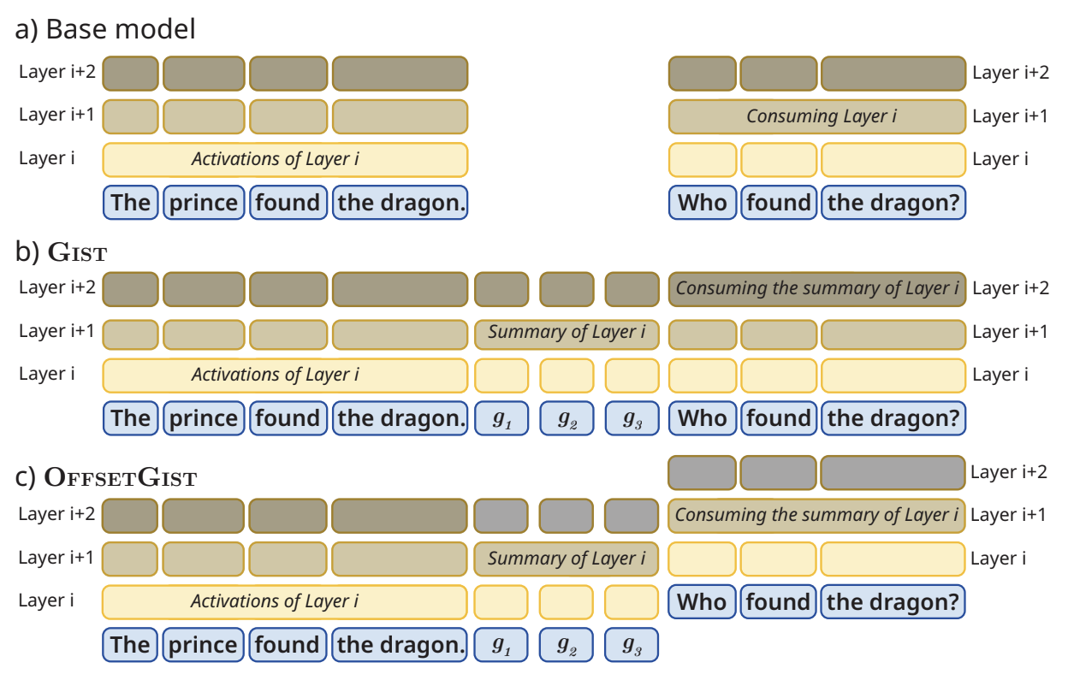
Activation Offsetting

Slide 19
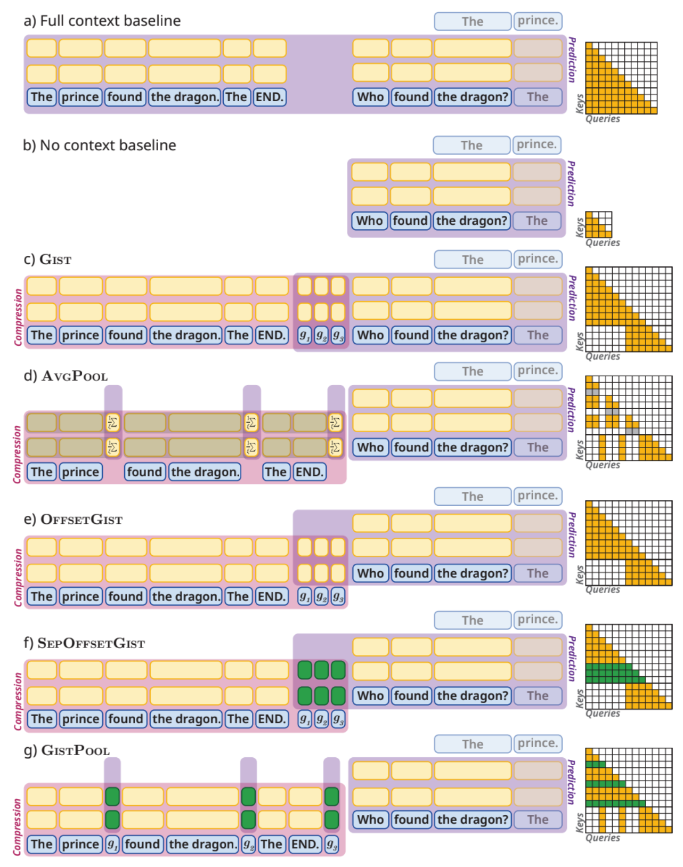
Conclusions
Paper available at go/gistpool
We are looking for use product cases for our model.

